Slide 1




AUTOMATED TRUCK QUEUEING MANAGEMENT SYSTEM WITH SMS NOTIFICATION FOR DHL SUPPLY CHAIN - AVON
Abrina, Botona, Evangelista, Mahinay

Slide 2
Introduction
Reduce the truck congestion
Easiest way to store information base on a given document
Automated Dock-Door Assignment
Short Message Service Notification
Performance Data Analytics for Business Decision

Slide 3
Project context
The improper management of such queues
Logistical procedures are often outdated and disorganized
That’s helps service provider to manage
Will help to ease the customer flows

Slide 4
Purpose and description
Will help to ease the process of queueing
To apply a business intelligence and create models to predict issues
Report capabilities for future outcome

Slide 5
Objectives
Implement a System that will improved queueing process
Increase service reliability
Monitor live updates with the use of SMS notification
Producing Statistical Reports for management decision making

Slide 6
Scope
Displays real time update via LCD monitors displays.
Trucker will be notify on the update via SMS
Generate a daily receiving report that can be use by top management
Compute Daily receiving Timeliness.

Slide 7
Limitation
This system limited only for DHL Supply chain Philippines
Does not support transaction process
SMS notification is disabled when internet is disconnected
Online analytical data reports is disable when internet is disconnected

Slide 8
Related Studies
Local Studies
Veluya (2015)
Lumauag (2016)
Tico (2016)
Cosidon (2016)
Abapo (2017)

Slide 9
Related Studies
Foreign Studies
Woottichaiwat (2015)
Padberg (2015)
Ngorsed and Seusaowaluk (2016)
Udin (2016)
Jhala and Bahathawala (2017)

Slide 10
Related Studies
Local Literature
Austria (2015)
Miranda (2019)

Slide 11
Related Studies
Foreign Literature
Najdenov and Makhoul (2015)
Jhala and Bhathawala (2016)
Farayibi (2016)
Jaiswal (2017)
Sajid (2017)

Slide 12
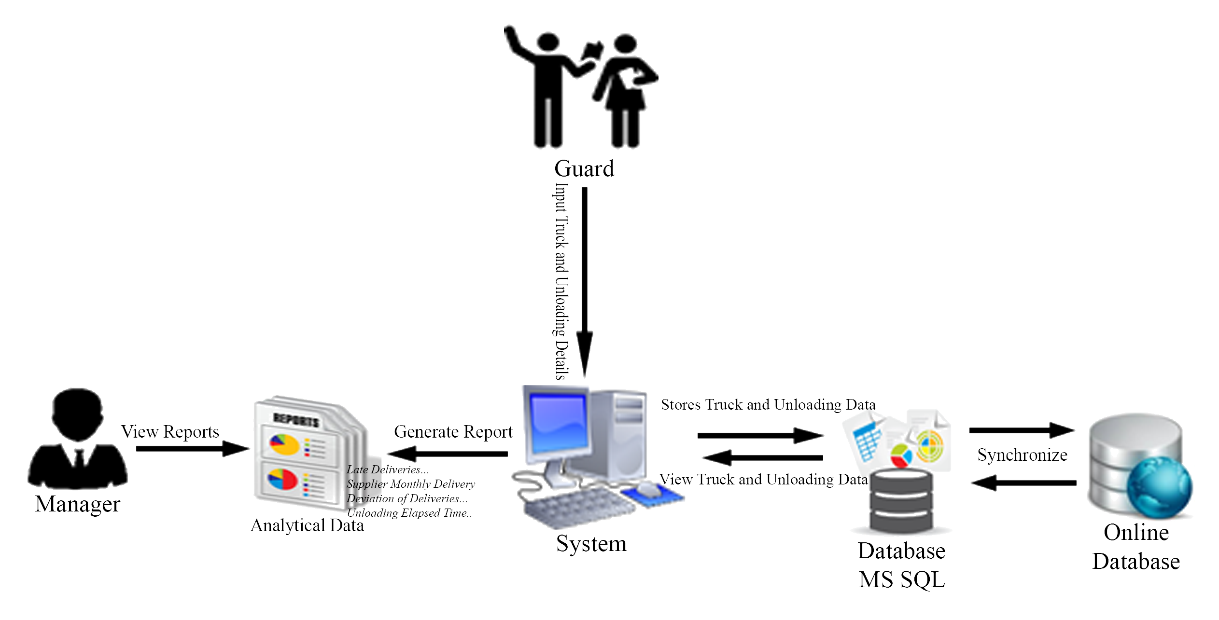
Technical Background
Block Diagram

Slide 13
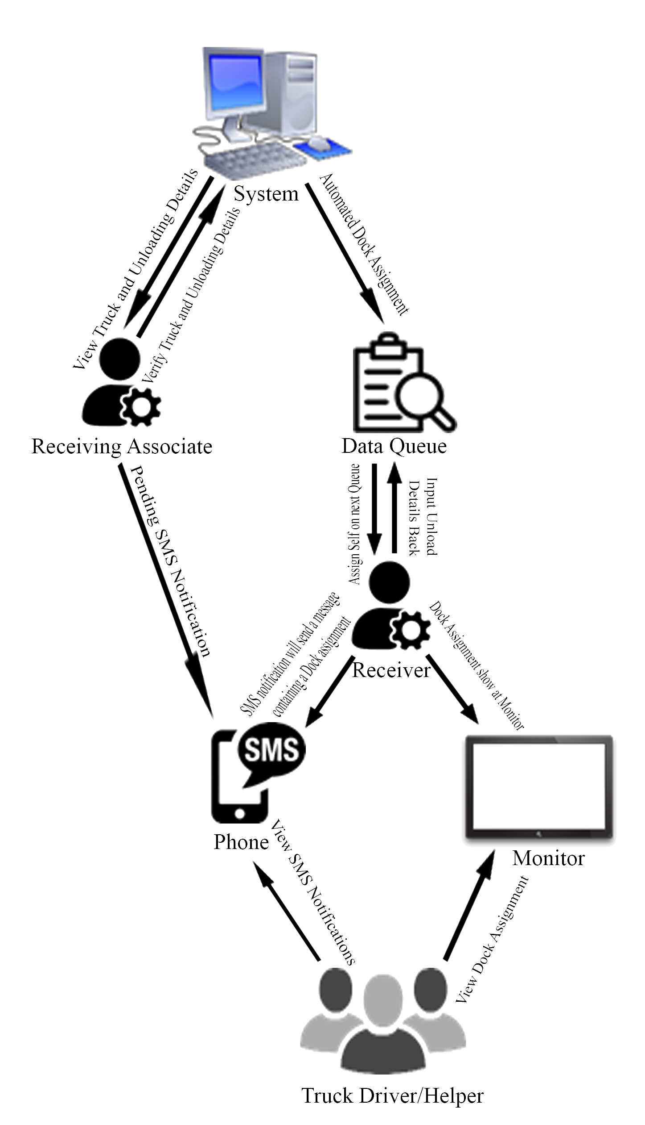
Technical Background
Block Diagram

Slide 14
Technical Background
Block Diagram
Guard Encode
Q4
Data Queue
Receiving Associate
Q3
Q2
Pending Document
Q1
Dock 1
Dock 2
Dock 3
No Show
Queue Monitor

Slide 15


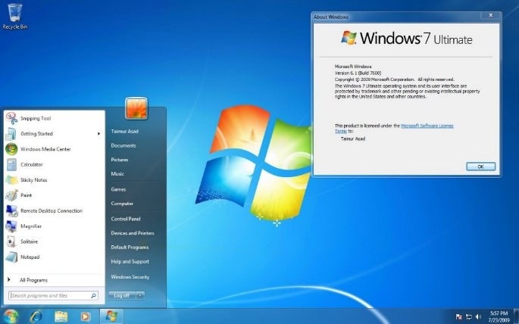
System Prerequisites
Microsoft Visual Studio
Microsoft SQL Server
Windows 7

Slide 16



System Prerequisites
Computer Set
Monitor
Mobile Phone

